Slide 1
Science code in the public sector
Peter Ellis
August 2017

Slide 2
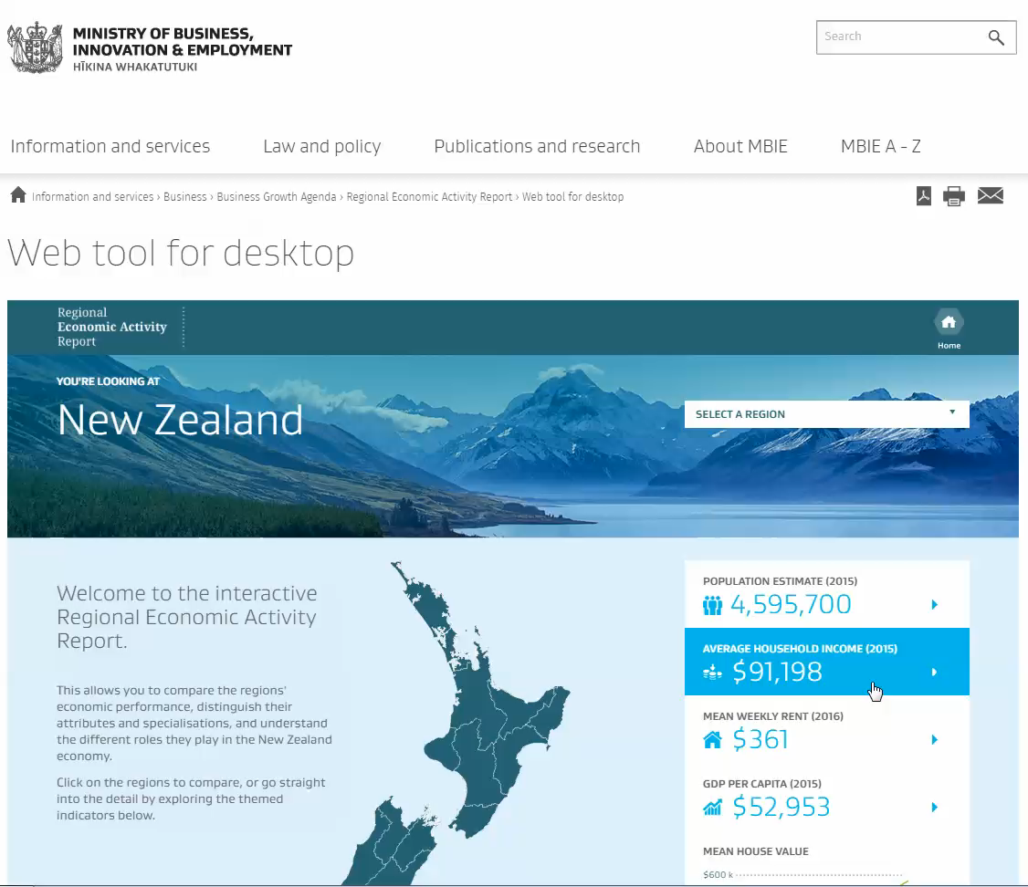

Slide 3
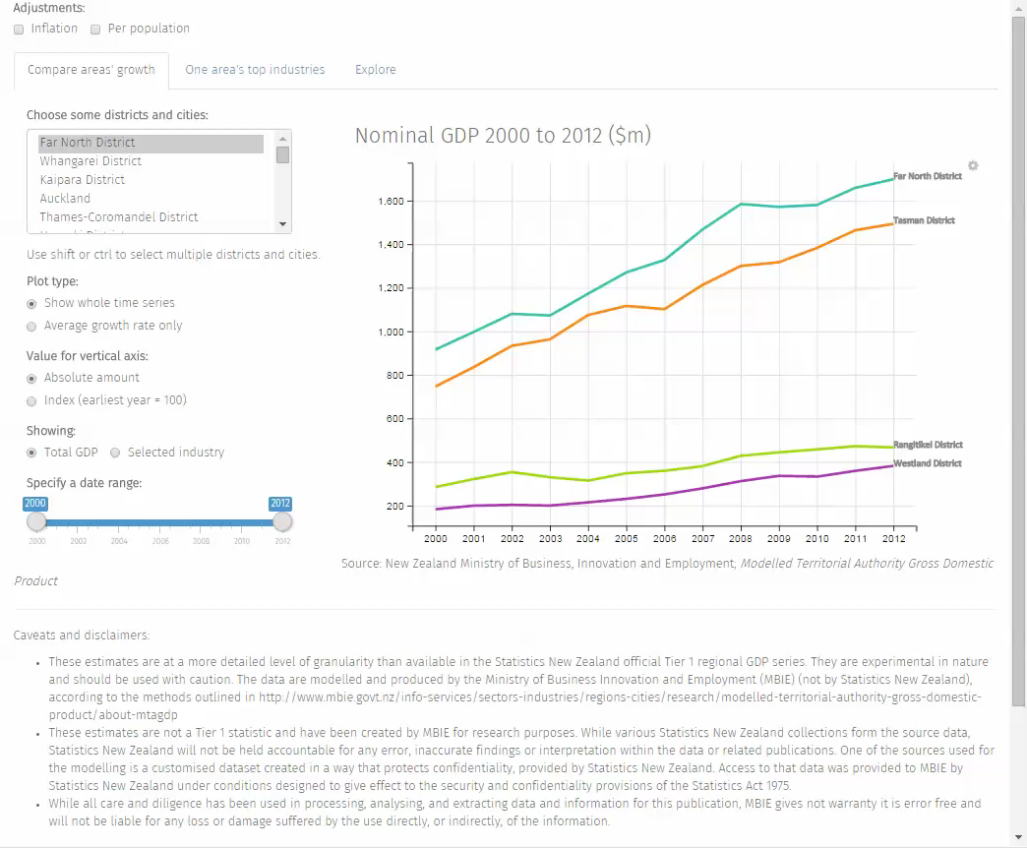

Slide 4

http://platosallegory.com/

Slide 5
What’s needed
Defining good practice

Slide 7
Demand for data skills exceeds supply
For my old MBIE team, this is in four areas:
New, improved, quicker, highly quality-controlled and cheaper official statistics making use of new administrative data sources such as credit card transactions
Better, more frequently updated, more comprehensive interactive web access
Better management and access for analytical re-use of internal data
More insightful use of statistical modelling and inference for forecasting, scenario exploration, and predictive analytics

Slide 8
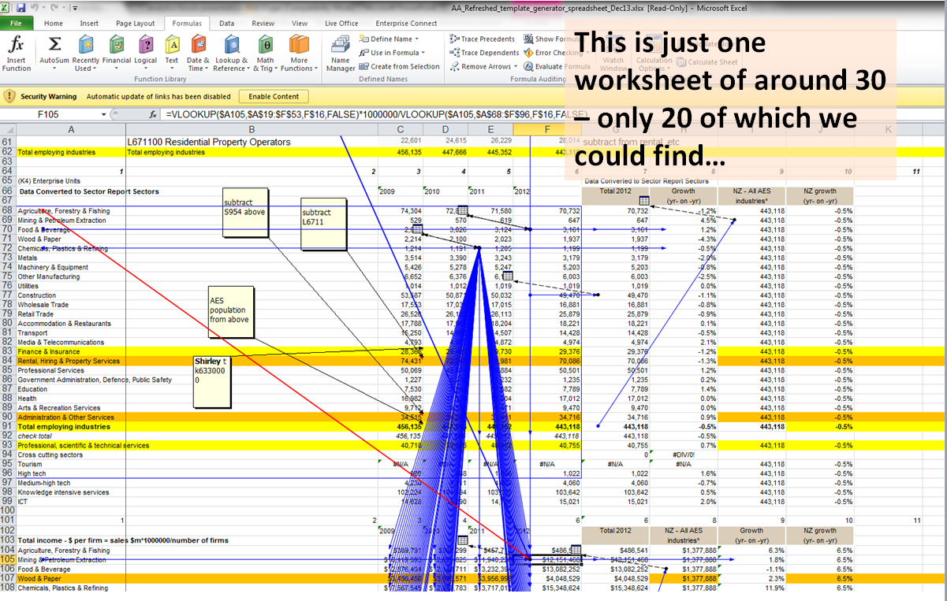

Slide 9
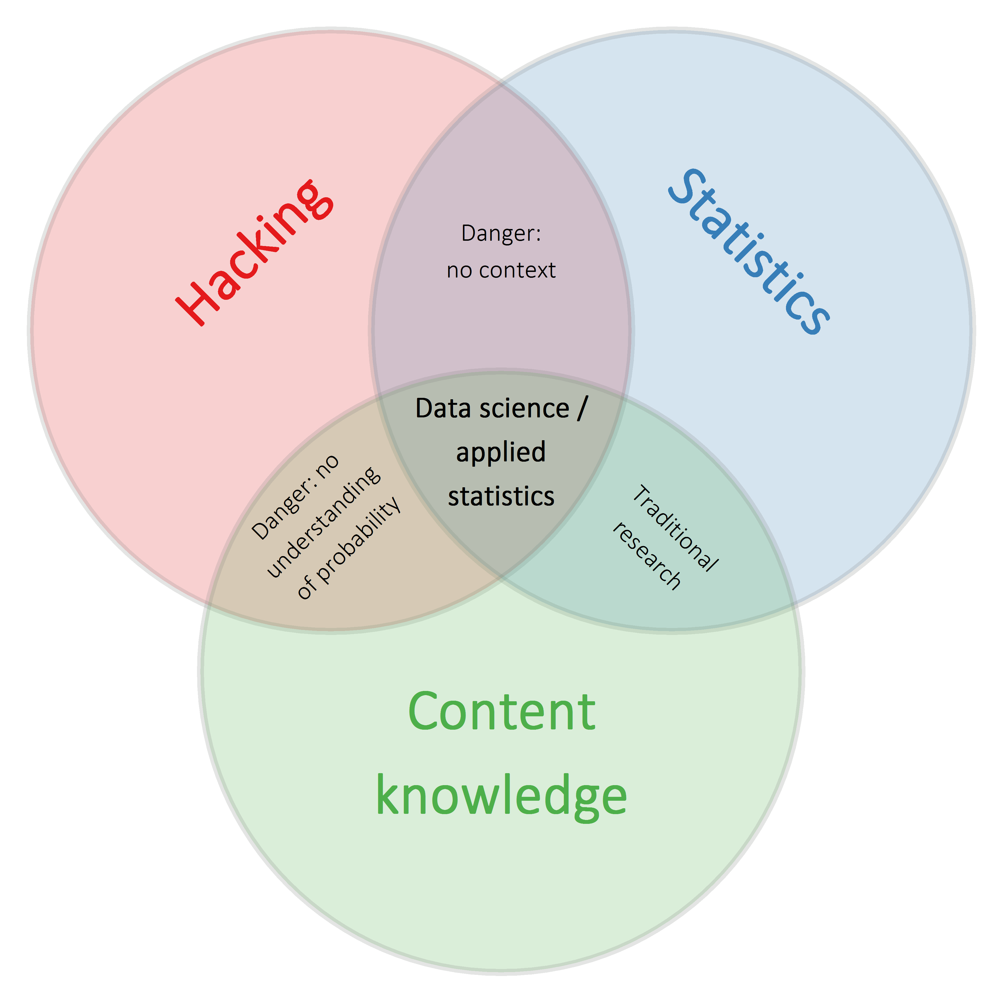
Adapted from http://drewconway.com/zia/2013/3/26/the-data-science-venn-diagram

Slide 10
Sector Trends approach and tool chain
Everything in code
Everything reproducible
Best-in-breed rather than end-to-end IT solutions
Flexible and medium term rather than permanent solutions
Approaches borrowed from software development
Version-controlled
Modular code
Constant peer review / programming in pairs
Continuous or frequent integration
Test-led development
Integrated documentation processes

Slide 11
Joel’s twelve point test for software teams
Do you use source control?
Can you make a build in one step?
Do you make daily builds?
Do you have a bug database?
Do you fix bugs before writing new code?
Do you have an up-to-date schedule?
Do you have a spec?
Do programmers have quiet working conditions?
Do you use the best tools money can buy?
Do you have testers?
Do new candidates write code during their interview?
Do you do hallway usability testing?
Joel Spolsky
https://www.joelonsoftware.com/2000/08/09/the-joel-test-12-steps-to-better-code/

Slide 12
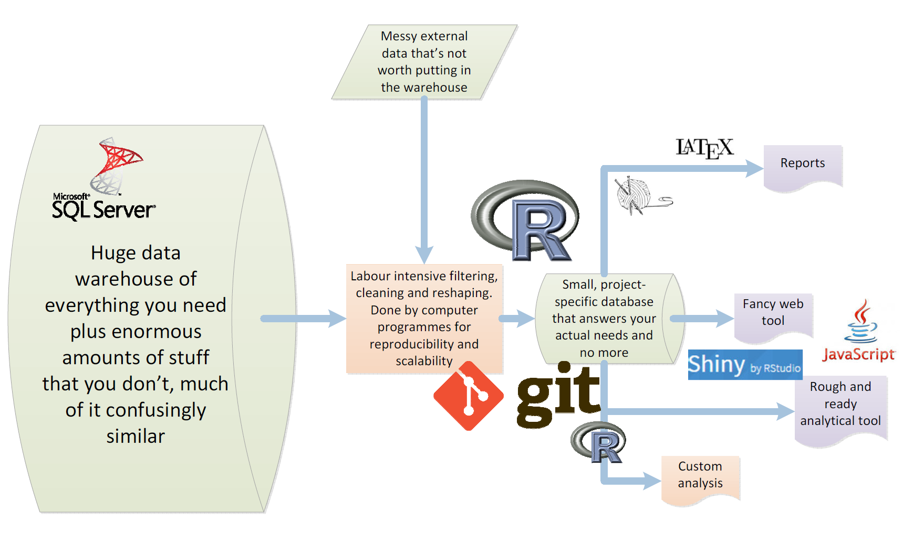

Slide 13
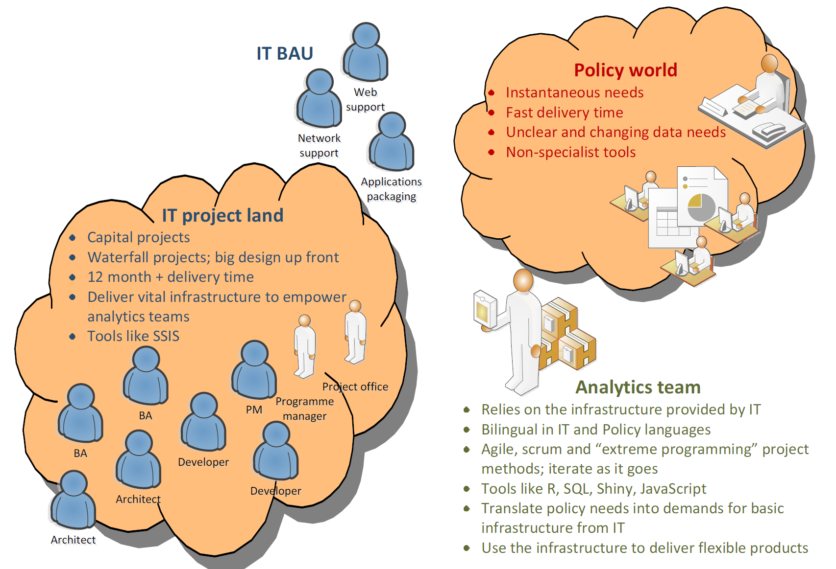

Slide 14
Capability building
Helping analytical teams escape the cave of being “team type 1”

Slide 15
Four types of analytics team
Mostly using Excel
Mostly using a coding tool (R, SAS, Python - whatever)
Like #2, but with version control, style and peer review
Like #3, but with good practice from software engineering
Notes:
Those for whom most work is done in Excel, particularly data management and presentation and visualisation of results. Specialist tools like SAS, Stata, Matlab, R or E-views used only for statistical/econometric modelling tasks that are beyond Excel.
Those for whom most work, including data management and visualisation, is done in a coding language which is usually one of R, SAS or Python plus SQL, but version control is limited to copies of files and date-stamped naming conventions.
Like #2, but with version control software, a coding style guide, and thorough peer review processes.
Like #3, but with more good practice borrowed from the software development world - like unit testing, regression testing, validation checks, release cycles, modular code, high coverage documentation, and continuous integration.

Slide 16
The reality in public sector analytics
Function | Good practice | Common practice
Data storage | Databases, enterprise warehouse | Mixture of flatfiles on network & databases
Miscellaneous data reshaping, tidying, cleaning | Code (language doesn’t matter) | Excel
Interacting with web | Code for both APIs and screen scraping | By hand and browser, if done at all
Simple analysis (cross-tabs etc) | BI tools for common queries, code for data pipelines | Market research or BI tools
Specialist analysis | Special statistical tool | Special statistical tool
General presentation and visualisation | Flexible tool with full range of techniques | Excel
Polished downstream products | HTML and JavaScript (developed quick and cheap) | Proprietary tools

Slide 17
Five key capability dimensions
Statistical exploration, modelling, inference and presentation
Statistical and data visualisation computing tools
Data storage tools and methods
Data manipulation
Workflow including version control, teamwork, documentation, style, etc

Slide 18
Keys to success in capability building
Workplace-specific environment, data and problems
Use staff rather than external trainers wherever possible
Create an atmosphere of continuous learning, improvement and change
Well defined, relatively short, sequenced modules
Management and senior management commitment, and acceptance it’s going to get worse before it gets better.
Time.
Prepared to change recruitment approach.

Slide 19
Example timeline – MBIE Sector Trends
2010 | Merge old Ministry of Tourism into Ministry of Economic Development; new senior management Initiate review of Tourism Data
2011 | New manager, given job to increase quantity and quality of analytical output and ‘insight’ Tourism data review finished and Domain Plan published First internal ‘statistical seminar’ series kicked off, but soon realise more to it than ‘statistics’ SAS, Stata, SPSS and R all evaluated and R chosen on basis of data manipulation, graphics, and cost
2012 | First use of databases, for regional tourism data; we discover SQL and RODBC out-perform the Business Intelligence tools provided by IT Abandon search for ‘the right’ external course and contract external trainer Use of RCommander as a transition step With natural turn-over, can start recruiting based on stats / data / computing skills, not tourism

Slide 20
Timeline - 2
2013 | Larger team created with responsibilities for other data areas – science, regions, sectors Begin to grapple with problems of complex synthesis of data Partnership with Dragonfly Data Science – we discover Git, JavaScript, team workflow improvements
2014 | First Sectors Report and Regional Economic Activity webtool Training moves to primarily in-house
2015 | Team expands again with new money to “sort” science data. ‘Data ninjas wanted’ advert. We start modularising training and making it sequential
2016 | Restructure into three domain areas finally complete Three main courses - “R Fundamentals”, “Graphics Fundamentals” and “Statistical Inference Fundamentals” form a basic building block and we start regularly repeating, rolling out across Branch and some other parts of Ministry Significant outreach to other departments begins (buddying, sharing training)

Slide 21
Results
A growing list of tangible outputs that would otherwise be impossible
Regional Tourism Estimates (2012, 2013, 2016)
International Visitor Survey Redevelopment (2013)
Modelled Territorial Authority Gross Domestic Product (2015)
Tourism forecasts brought in-house (2015)
New Zealand Tourism Dashboard (2016)
Regional Economic Activity Report (2014, 2015, 2016)
mbiemaps and other R packages
Expanding beyond the team
60+ people from rest of Ministry
6+ from other agencies

Slide 22
Reflections
Challenge of very unequal and uneven backgrounds
Workflow, version control, team work, software dev skills usually the big deficit
Surprising amount of re-learning stats you’d think people knew before….
Datacamp, Johns Hopkins / Coursera, swirl all good resources
Not all analysts will be the best trainers…
Interest from other managers in expanding, but:
Difficult to get commitment to time etc – other priorities come up
We’ll need to productionise and professionalise some of our training – increasingly we are turning lectures into videos, use online courses, put our material into online courses, better and more systematic formative feedback (low stakes tests etc)
Buddy systems with other teams and departments looking potentially fruitful
A difficult challenge for a manager given push towards generic / non-technical

Slide 23
Example projects
Tourism forecasts, and Modelled Territorial Authority GDP

Slide 24
Story 1 - forecasts
Econometric forecasts combined with expert judgement
Many re-runs of the data
time pressure
version control challenges
many in-text numbers to update
Five people working on report simultaneously
Interactive web-app
Range of custom graphics needed
Solution was the workflow:
database – R – knitr – LaTeX – Shiny

Slide 25


Slide 26
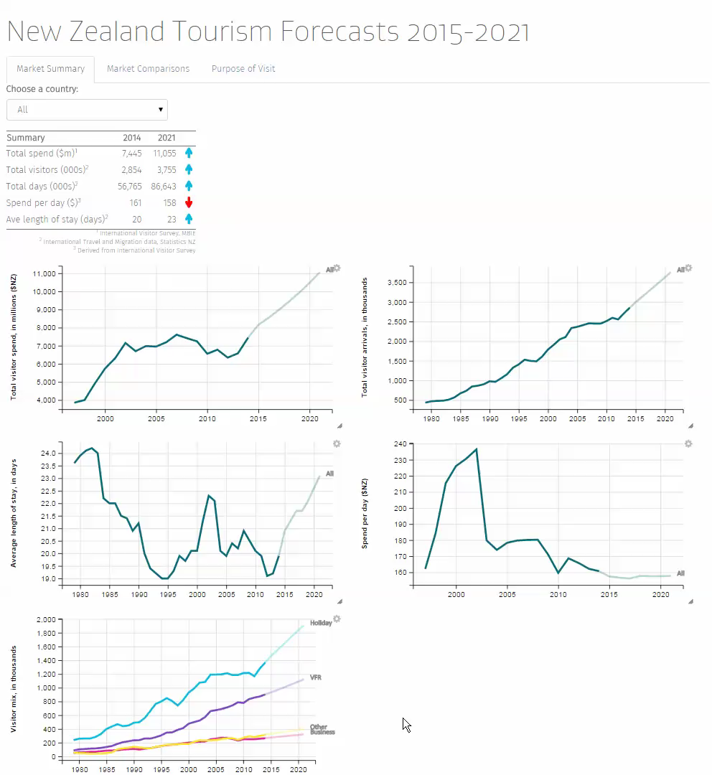

Slide 27
Story 2 – modelled Territorial Authority GDP
Bring together multiple datasets in complex concordance
Small-area estimation methods
Meet strong policy demand for district/city level economic measure that is consistent with published national and regional GDP
Draw on granular employment data to allocate GDP by industry and small areas

Slide 28
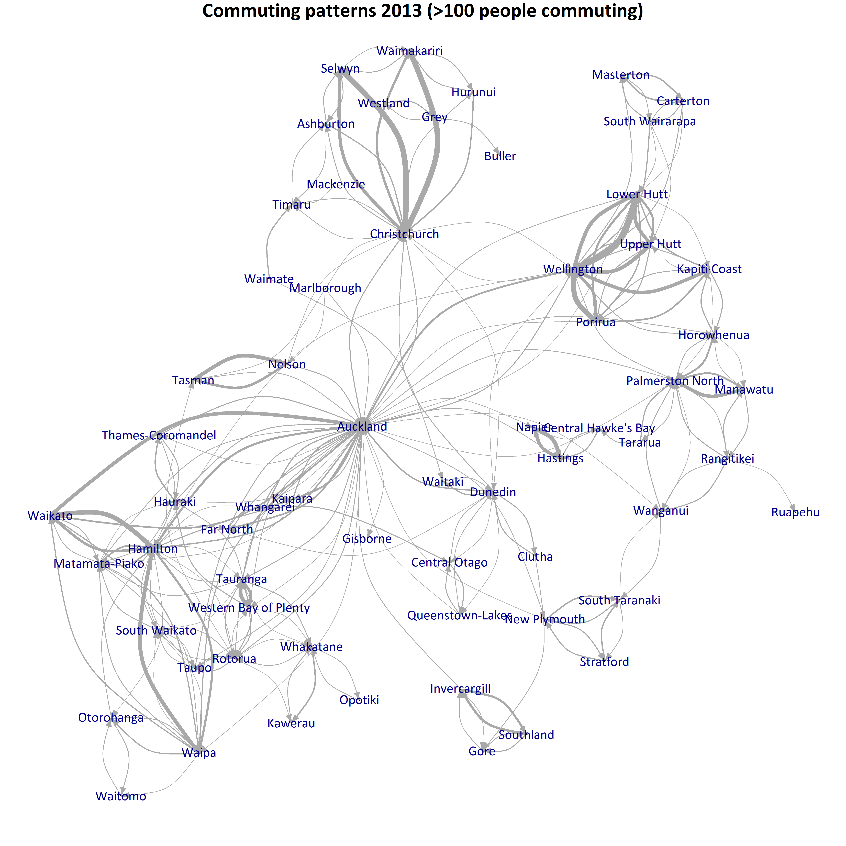
Commuter correction
LEED earnings data is published on basis of residence, not place of work.
We corrected for this by moving a proportion of earnings based on residence-workplace averages in the 2013 census

Slide 29
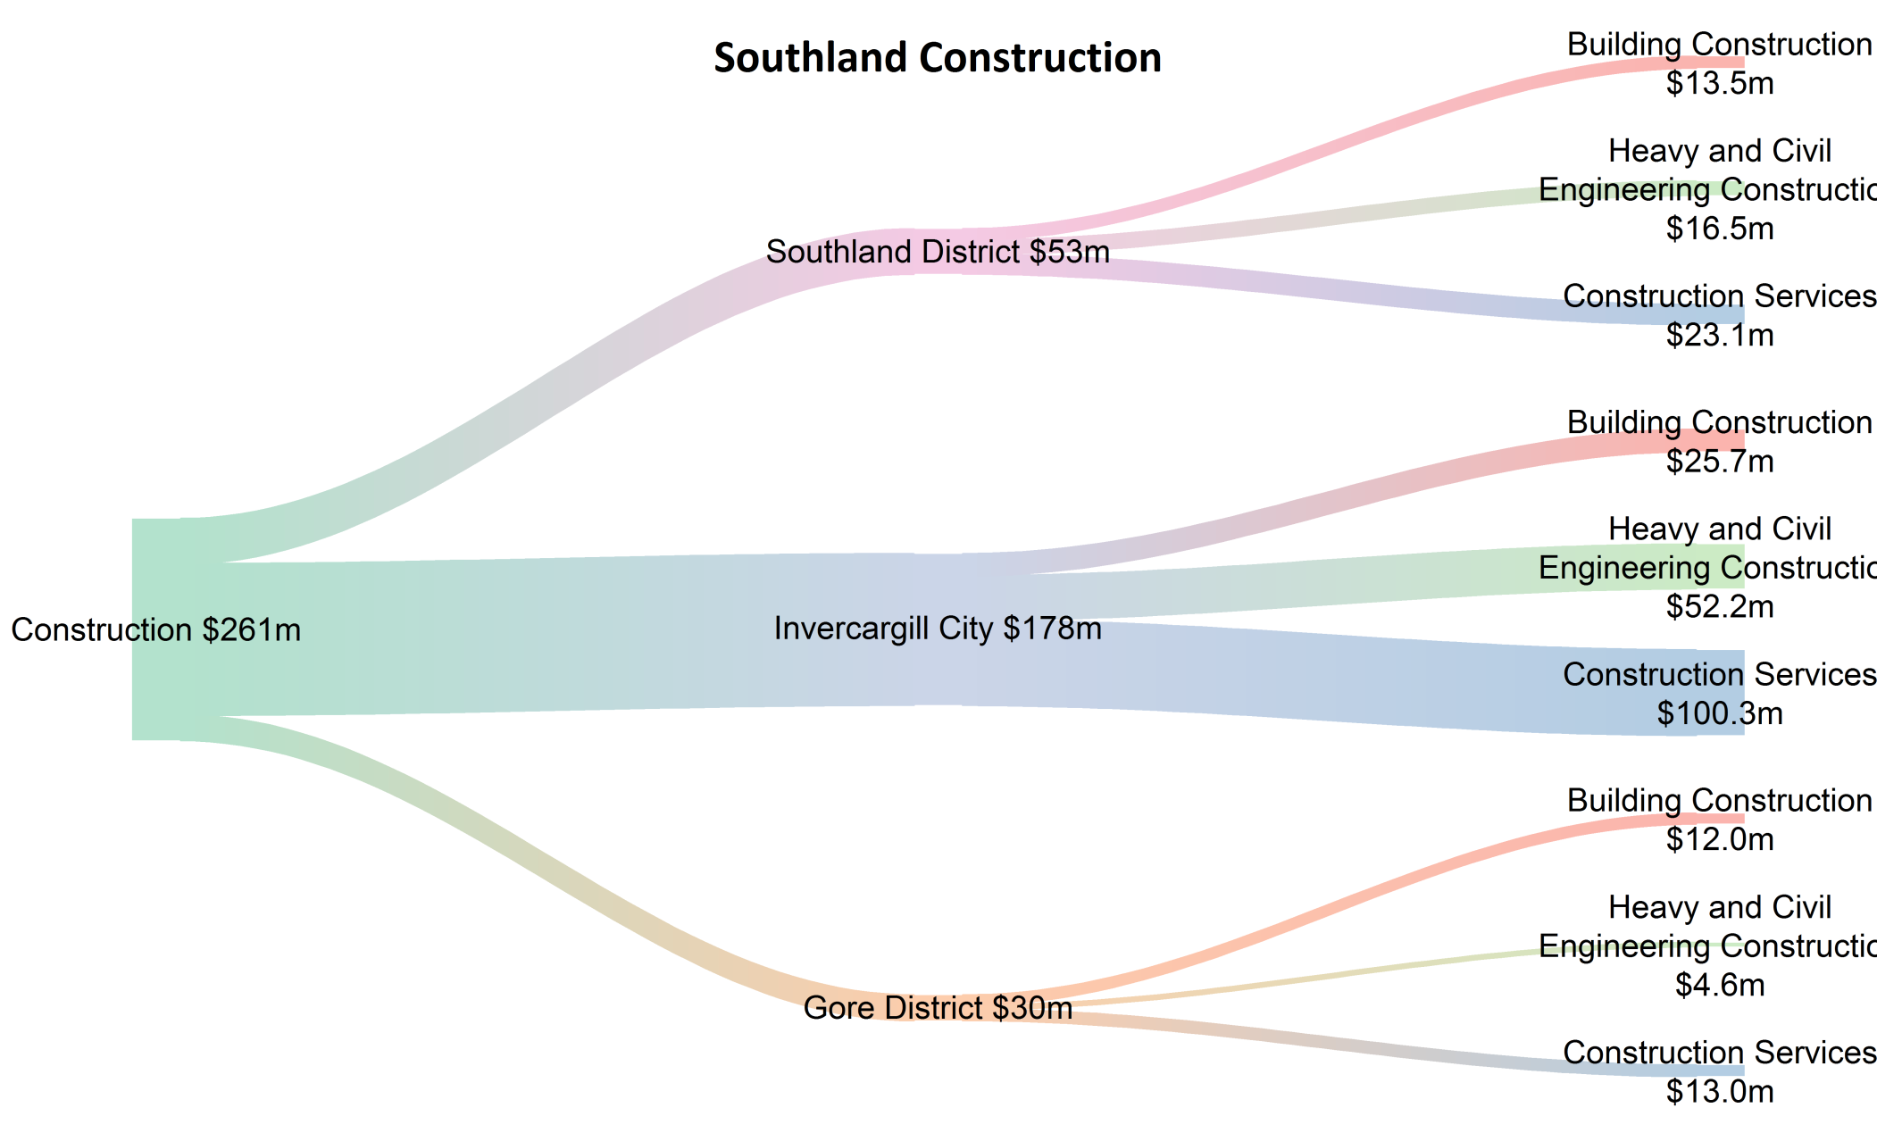
Example results

Slide 30
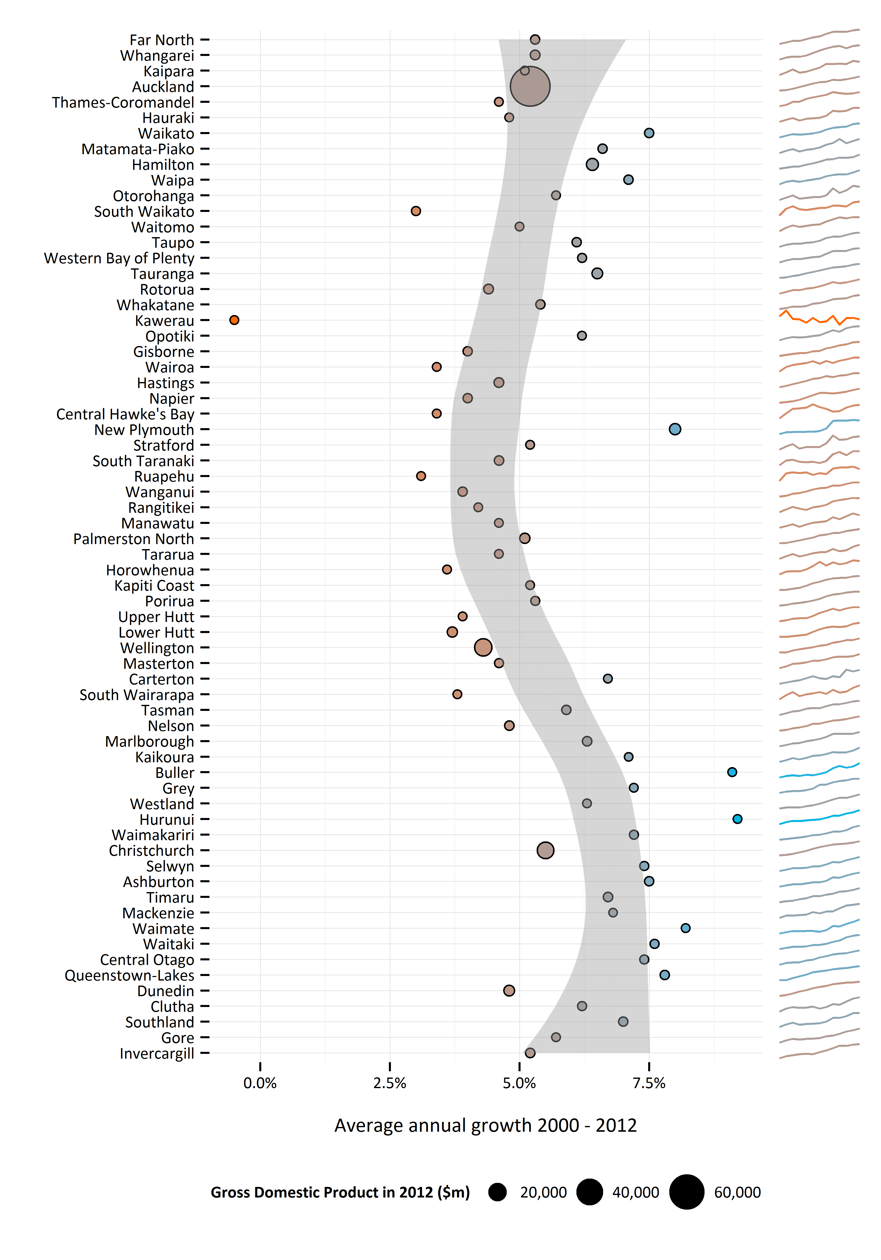
Total GDP
Territorial Authorities sorted by latitude allows a rough visual feel for geography.
South Island TAs generally have grown more in the 2000 – 2012 period than those in the north island.

Slide 31
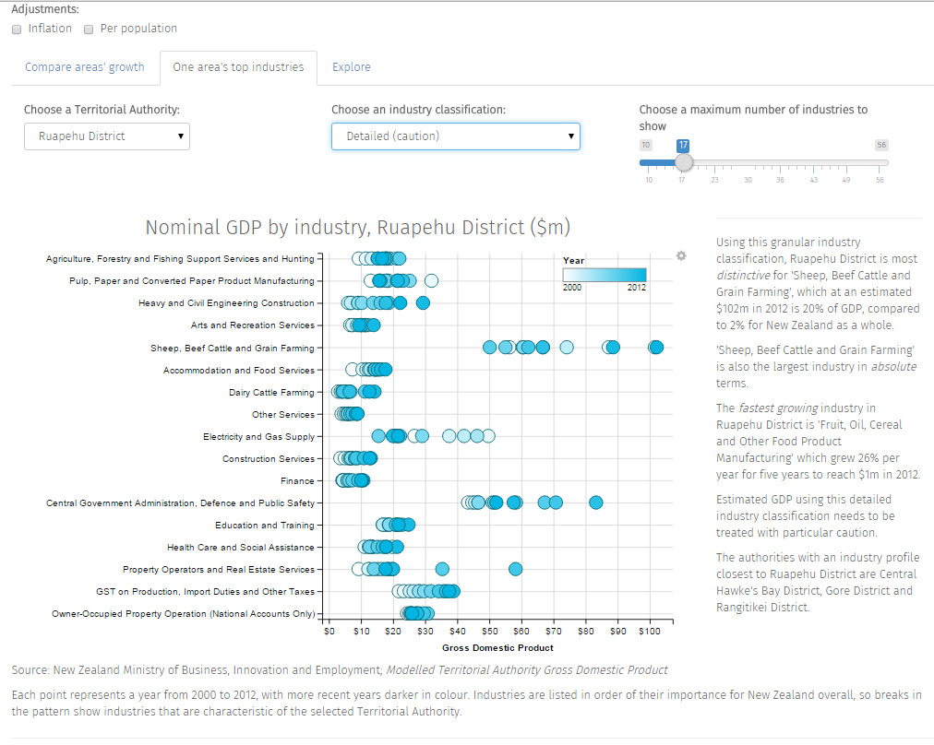

Slide 32
About me
https://ellisp.github.io/
@ellis2013nz
Principal Data Scientist, Stats NZ
ex:
General Manager Evidence and Insights, Social Investment Agency
Manager Sector Trends, Ministry of Business, Innovation and Employment
Manager Tourism Research & Evaluation, Ministry of Economic Development
Counsellor Development Cooperation Timor Leste, AusAID
Director Program Evaluation, AusAID
But today’s talk in my own capacity, not representing any employers

Slide 33
http://platosallegory.com/

